Slide 1
NVRH
Response to Hearing Follow-up Questions
September 4, 2019

Slide 2
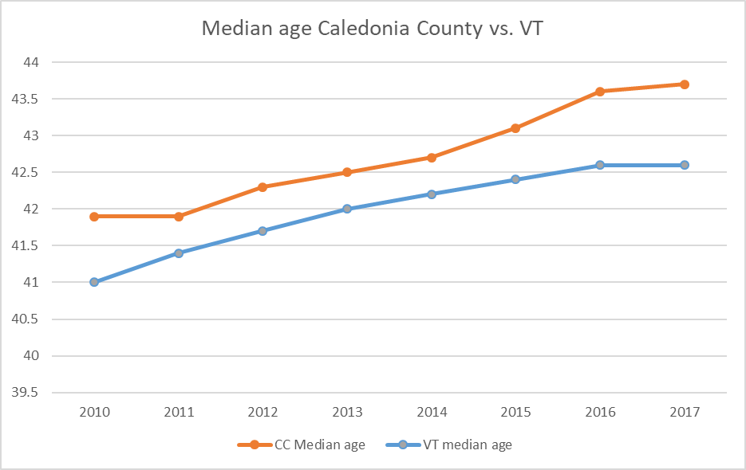
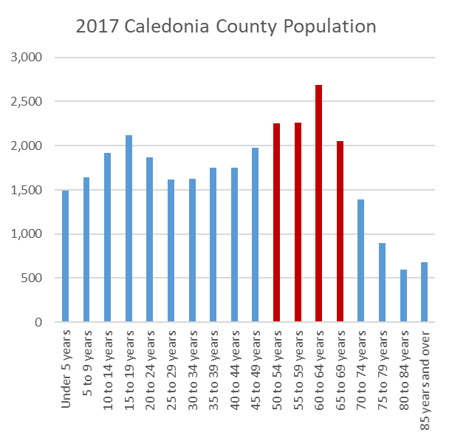
Q1. Justification for NPR Growth
– Our HSA Demographics

Slide 3
Q1-Cont’d. Justification for NPR Growth
- Orthopedic Visits Still Increasing but Slowing Down

Slide 4
Q1-Cont’d. Justification for NPR Growth
– Inpatient NPR from Unique NH Residents Increasing

Slide 5
Q1. Justifcation for NPR Growth-Outpatient NPR from Unique NH Residents Increasing

Slide 6
Q1-Cont’d. Justification for NPR Growth
– NVRH Case Mix Index Continues to Increase
Vermont Hospital Case Mix Index
 | Hospital Fiscal Year (10/1 - 9/30)
Hospital | 2015 | 2016 | 2017 | 2018 | 2019*
BMH | 1.24 | 1.26 | 1.24 | 1.22 | 1.19
Copley | 1.20 | 1.23 | 1.28 | 1.35 | 1.41
CVMC | 1.22 | 1.24 | 1.21 | 1.28 | 1.42
Gifford | 1.01 | 1.02 | 1.01 | 1.04 | 0.93
Grace Cottage | 0.87 | 0.91 | 0.87 | 0.92 | 0.88
MAHHC | 1.14 | 1.06 | 0.98 | 1.06 | 1.03
NCH | 1.04 | 1.05 | 1.05 | 1.06 | 1.10
NMC | 1.32 | 1.37 | 1.35 | 1.31 | 1.33
NVRH (*) | 1.18 | 1.20 | 1.21 | 1.22 | 1.30
Porter | 1.12 | 1.20 | 1.17 | 1.28 | 1.29
RRMC | 1.34 | 1.38 | 1.38 | 1.35 | 1.34
Springfield | 1.04 | 1.05 | 1.03 | 1.06 | 1.06
SVMC | 1.25 | 1.23 | 1.25 | 1.23 | 1.23
UVMMC | 1.70 | 1.75 | 1.77 | 1.75 | 1.75

Slide 7
Q2. Steps to Reduce Preventable ED Visits – What’s Already in Place
All primary care practices now fully staffed and accepting new patients
ED care managers monitor and follow-up on patients with no PCP
ED care managers and primary care coordinators constantly focused on avoidable ED visits
Recovery coaches available 24/7 for substance abuse disorder patients seeking help, reducing return ED visits
Ongoing patient education around calling PCP before trip to ED
Pediatricians see patients day and night to avoid ED visits

Slide 8
Q2-Cont’d. Steps to Reduce Preventable ED Visits – Convenient Care Initiative
Fall 2019 rollout
Emedded ED provider in clincs
Expanded office hours Monday-Friday
Saturday clinic hours

Slide 9
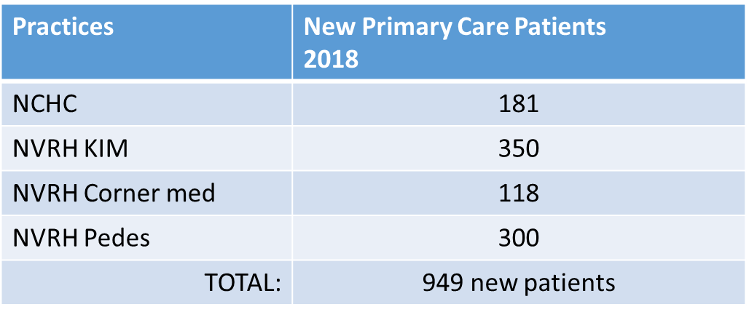
Q2.- Cont’d Steps to Reduce Preventable ED Utilization- Improve Access to Primary Care

Slide 10
Q2.- Cont’d Steps to Reduce Preventable ED Utilization- FY 2020 NPR Impact
Proposed Changes to Visits and NPR:
Original Budgeted Visits
15,200 ED plus
1,000 Convenient Care
Move Up Convenient Care Opening to Fall, 2019 and Continue Focus on Reducing Preventable Visits
Revised Budgeted Visits
14,200 ED plus
1,500 Convenient Care
NPR Impact – $310,000 NPR Reduction

Slide 11
Q3. Provide Demographics on Patients Returning To NVRH – St J HSA Inpatient Medicaid Admission % by Hospital

Slide 12
Q4. Provide Information on Unique Patients – Unique NH Outpatient Visits to NVRH Increasing

Slide 13
Q5. Cost Savings Initiatives
Maximize 340B Savings $1,000,000 (Annual) *
Maximize GPO Drug Contracts $ 325,000 (Annual)
Maximize GPO Supply Contracts $ 419,000 (Annual) **
Elimination of 3.9 FTES $ 232,500 (Permanent)
Temporary Staffing Reduction $2,000,000 (One Time)
LED Lighting Project Savings $ 33,000 (Annual)
Net Metering Project Reduction $ 36,000 (Annual)
ECRI Capital Purchase Savings $ 40,000 (Annual)
* $200,000 new budget 2019 to budget 2020
** $ 90,000 new budget 2019 to budget 2020

Slide 14
Q6. Does NVRH Agree with DVHA’s Financial Impact of Increased Medicaid Reimbursement on NPR?
DVHA estimates a $150,000 Medicaid reimbursement increase. We estimate the effect will be $100,000
The DVHA baseline is CY 2018 utilization, which is before NVRH’s participation in OCV Medicaid Next Gen Risk Model
DVHA OPPS increase won’t apply to attributed Medicaid lives in the risk program, or approximately 1/3 of NVRH’s Medicaid patient base
OCV has increased NVRH’s 2020 maximum risk, a net revenue reduction, by $160,000 thereby eliminating the $100,000 potential positive impact of increased OPPS reimbursement

Slide 15
7. Does CMS Wage Index Final Rule Effect NVRH
No. As a Critical Access Hospital NVRH is not effected by the CMS Wage Index Final Rule

Slide 16
8. If Medicare Reimburses $100 for a Service What Would Commercial Payers and Medicaid Reimburse for the Same Service?
Medicare reimbursement =$100
Average commercial reimbursement = $160
Medicaid reimbursement = $72

Slide 17
9. Provide Update on TCOC
*
Cost Per Member Per Month Feb 2018-Jan 2019 | OneCare | St. Johnsbury
Total | $263.038 | $296.04
Inpatient Medical | $15.85 | $14.17
Inpatient Surgery | $26.10 | $27.19
Maternity | $8.461 | $5.47
Outpatient Surgery | $14.43 | $17.06
Emergency Department | $15.32 | $16.68
Advanced Imaging | $5.84 | $6.62
Pathology/Lab | $8.67 | $8.09
Medical Pharmacy | $11.20 | $21.72 *
DME and Supplies | $8.15 | $7.04
Preventive³ | $10.55 | $4.53
All other claims combined² | $104.43 | $116.63
Confidential Claims¹ | $34.04 | $50.04
Cost Per Member Per Month January -July 2019 | OneCare | St. Johnsbury
Total | $233.98 | $246.04
Inpatient Medical | $14.56 | $14.12
Inpatient Surgery | $23.11 | $26.71
Maternity | $6.51 | $2.99
Outpatient Surgery | $12.97 | $13.10
Emergency Department | $13.80 | $16.28
Advanced Imaging | $5.32 | $6.95
Pathology/Lab | $8.72 | $7.06
Medical Pharmacy | $11.69 | $19.33 *
DME and Supplies | $8.15 | $6.81
Preventive³ | $8.75 | $4.32
All other claims combined² | $101.89 | $109.82
Confidential Claims¹ | $18.51 | $18.56

