Slide 1
2018 Total Cost of Care Results & APM Technical Changes Update
Sarah Lindberg
Alena Berube
Michele Degree
February 26, 2020

Slide 2
2018 Total Cost of Care Results

Slide 3
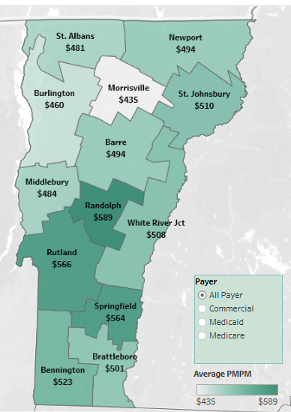
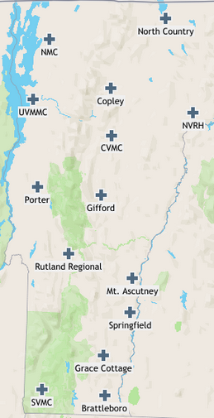
Two Main Lenses for Analysis
RESIDENT
PROVIDER
Based on where people live
$6.0 billion in 2017*
Based on where the care was delivered
$6.2 billion in 2017*
* Estimates from 2017 Expenditure Analysis, https://gmcboard.vermont.gov/sites/gmcb/files/2017_Expenditure_Analysis_with_projections_March_27_2019.pdf

Slide 4
Current Measure: APM TCOC Growth
The All-Payer ACO Model (APM) has two financial targets related to growth in the Total Cost of Care (TCOC), which are resident-based analyses. They measure how much the TCOC is changing on a per person basis for people who live in Vermont.
All-Payer TCOC Growth
Target: Growth from 2017 to 2022 should not be more than 3.5%.
Medicare TCOC Growth
Target: Growth from 2017 to 2022 should be 0.2 percentage points less than expected national growth.

Slide 5
APM All-Payer TCOC ≠ Hospital Budgets
Hospital Budgets
All-Payer TCOC
Medical claims and related expenditures for Vermont residents are included, WHEREVER the care is delivered.
Vermont hospital budgets measure a broad set of financial information for a hospital, WHEREVER the patients live.

Slide 6
APM All-Payer TCOC ≠ Insurance Rate Review
All-Payer TCOC
Insurance Rate Review
Insurers develop a premium for expected covered lives (Vermont and non-Vermont residents) to cover estimated future costs and risks for benefits included in insurance products.
Medical claims and related expenditures for Vermont residents are included, WHEREVER the care is delivered.

Slide 7
APM All-Payer TCOC ≠ ACO Budgets
All-Payer TCOC
ACO Budgets
An ACO budget includes a variety of financial information, including the accountable care arrangements (i.e. ACO TCOC) with each participating payer for those attributed to the ACO.
Attributed to ACO
Medical claims and related expenditures for Vermont residents are included, WHEREVER the care is delivered.

Slide 8
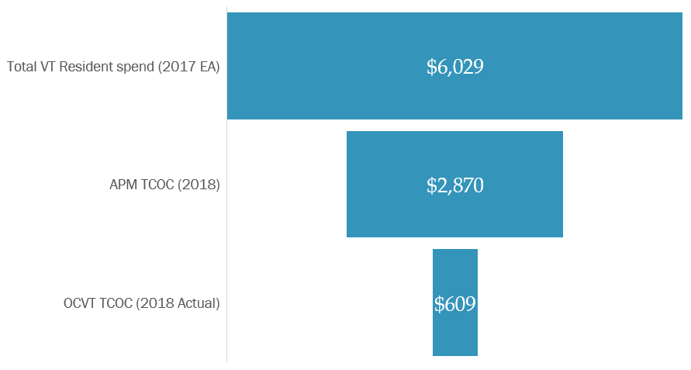
Comparing Expenditure Measures (in millions)
48% of total
10% of total
21% of APM TCOC

Slide 9
TODAY’S RESULTS: All-Payer TCOC Growth, Model Year 1
How did the per person TCOC change from 2017 to 2018 for all Vermont residents?
$$\frac{Per person TCOC in 2018}{Per person TCOC in 2017}$$

Slide 10
All-Payer Model Agreement Updates

