Slide 1
The Vermont All-Payer Accountable Care Organization (ACO) Model
Rural Health Services Task Force
July 18, 2019
Notes:
SARAH to introduce

Slide 2
Problem: Cost Growth is Unsustainable, and Health Outcomes Must Improve
Cost Growth
Health Outcomes
In 2017, the most recent year of data available, health care spending in Vermont grew 1.7%.
Vermont’s health care share of state gross product devoted to health care spending was 18.5% in 2017, vs. 11.8% in 1995.
Chronic diseases are the most common cause of death in Vermont. In 2014, 78% of Vermont deaths were caused by chronic diseases
High Blood Pressure: 25% of Vermonters diagnosed (2015)
Diabetes: 8% of Vermonters diagnosed (2015)
COPD: 6% of Vermonters diagnosed (2015)
Obesity: 28% of Vermont adults diagnosed (2016)
Medical costs related to chronic disease were over $2 billion in 2015, and are expected to rise to nearly $3 billion by 2020
Vermont’s death rates from suicide and drug overdose are higher than the national average
Suicide (2016): 17.3 per 100,000 (VT) vs. 13.4 per 100,000 (US)
Drug Overdose (2016): 18.4 per 100,000 (VT) vs. 13.3 per 100,000 (US)
Source: 2017 Vermont Health Care Expenditure Analysis, available at https://gmcboard.vermont.gov/data-and-analytics/analytics-rpts.
Sources: Vermont Department of Health, Kaiser Family Foundation
2
Notes:
SARAH - To put the All-Payer ACO Model in context, I’m going to start with a quote from the Board’s decision to sign the All-Payer Model Agreement:
The rising cost of health care imposes unsustainable financial burdens on Vermonters and their families, impedes equitable access to preventive care, and threatens to cripple our State’s economy. Left unchecked and uncontrolled, it will prevent Vermont from reaching its goal to ensure that all of its citizens have access to affordable, high-quality health care.
To couple this with data – the slide shows data from the Vermont Health Care Expenditure Analysis, which has been tracking Vermont’s health care spending since the 1990s. In 2017, the most recent year for which data is available, Vermont health care spending grew 1.7%.
We know that sustainability is a core focus of the Rural Health Services Task Force, and we think this dovetails perfectly with the goals of the APM.
-----
In 2015, Total nominal US health care spending increased 5.8 percent and reached $3.2 trillion. On a per person basis, spending on health care increased 5.0 percent, reaching $9,990. National Health care spending grew at 4.3% in 2016
Health care is also growing faster than our economy – the health care share of Vermont’s GSP has risen precipitously over the last 20 years, as has health care as a percent of national GDP.
Despite high spending, health outcomes must also improve. Though Vermont is consistently ranked one of the healthiest states in the nation, chronic disease, suicide, and drug overdose take a huge toll on Vermont and Vermonters.
Chronic diseases are the most common cause of death in Vermont. In 2014, the most recent year of data available, 78% of Vermont deaths were caused by chronic diseases
Vermont’s death rates from suicide and drug overdose are higher than the national average

Slide 3
Vermont’s Solution: The Vermont All-Payer Accountable Care Organization (ACO) Model
Test Payment Changes
Improve Outcomes
Population-Based Payments Tied to Quality and Outcomes
Invest in Care Coordination
Increased Investment in Primary Care and Prevention
Incorporation of Social Determinants of Health
Improve Quality
Improved access to primary care
Fewer deaths due to suicide and drug overdose
Reduced prevalence and morbidity of chronic disease
Transform Care Delivery
Notes:
MELISSA - Vermont is introducing payment reforms to reinforce and enable transformations in care delivery, with the ultimate goal being to achieve improvements in health and slower cost growth.
A key concept here is:
When you put providers at risk for the cost and quality of care delivered to patients, it will spur increased investments in and focus on primary care and prevention, since there is consensus that a strong primary care foundation with an enhanced focus on preventive services can improve health care quality, improve the health of the population, and help keep costs down.
The last column here describes the three population health goals that are found in the All Payer Model Agreement. These are health outcomes that Vermont is trying to positively impact through this model.
We’re currently early in Year 2 of the 5-year model, testing whether prospective payments can transform how communities are caring for their population

Slide 4
Vermont’s Responsibilities under the All-Payer ACO Model Agreement
Cost Growth and Population Health/Quality
Alignment and Scale
Limit spending growth on certain services
Separate targets for Medicare and “all-payer” beneficiaries (most Vermonters)
Meet targets for 20 quality measures, including three population health goals
Improving access to primary care
Reducing deaths due to suicide and drug overdose
Reducing the prevalence and morbidity of chronic disease
Ensure payer-ACO programs align in key areas, including
attribution methodologies
services
quality measures
payment mechanisms
risk arrangements
Steadily increase scale (the number of people in the model) over the five years of the Agreement
Notes:
SARAH – Vermont is responsible for a few things under the APM Agreement:
In the box on the left, you’ll see that the Agreement includes cost and quality targets.
Cost targets require Vermont to achieve sustainable cost growth for certain services for both Medicare and “all-payer beneficiaries,” which includes most Vermonters. The limit for cost growth in the Agreement, 3.5%, was selected as a sustainable growth target because it tied to state economic growth.
With respect to quality, the State is responsible for meeting targets on 20 different quality measures, including three statewide population health goals.
Moving to the box on the right, the State is also responsible for ensuring that ACO programs in Vermont are aligned with one another in certain key areas, including attribution (who’s a member of the ACO?), services for which the ACO is held financially accountable, quality measures, and payment mechanisms and risk arrangements (the ACO’s financial arrangements with payers).
Finally, the All-Payer Model signatories are responsible for steadily increasing the scale of the model over the life of the agreement – the number of Vermonters who are ACO members – which will happen as more payers and providers decide to contract with the ACO and to expand their participation to new service lines.
Scale and alignment are both important for ensuring that providers have strong, consistent incentives to make changes that will reduce cost and improve quality. Multi-payer alignment on things like quality measures also supports decreased provider administrative burden.

Slide 5
Improving the Health of Vermonters How will we measure success?
Vermont is responsible for meeting targets on 20 measures under the Model
Process Milestones and Health Care Delivery System Quality Targets support achievement of ambitious Population Health Goals
Process Milestones
Health Care Delivery System Quality Targets
Population Health Outcomes
Goals selected based on Vermont’s priorities:
1. Improve access to primary care
2. Reduce deaths due to suicide and drug overdose
3. Reduce prevalence and morbidity of chronic disease
Notes:
SARAH – Now we’ll dig into quality a little. As mentioned on the previous slide, Vermont is responsible for meeting targets on 20 measures under the Model. These fall into 3 buckets:
1. Process Milestones – Ensuring that the State and ACO are striving towards improvement on quality and population health. EXAMPLE: Rate of adults receiving MAT.
2. Health Care Delivery System Quality Measures and Targets – Measures and targets evaluating ACO performance and quality of care; for these measures, the population is people attributed to the ACO. Measures can be multi-payer or payer-specific. EXAMPLE: Initiation of Alcohol and Other Drug Dependence Treatment.
3. Population Health Outcome Measures and Targets – Statewide measures and targets related to the health of the population, regardless of whether the population seeks care or not. Population generally includes all Vermonters. These measures are unique to Vermont’s model – we’re one of the first initiatives to commit to big statewide health improvement goals as part of a major delivery system and payment reform model. Each of the Process Milestones and Health Care Delivery System Quality Targets supports achievement of one of the statewide Population Health Outcomes. EXAMPLE: Deaths from drug overdose.

Slide 6
Vermont All-Payer ACO Model Partners
Green Mountain Care Board (GMCB)
Governor, Vermont Agency of Human Services (AHS) Including Medicaid
ACO (OneCare Vermont) and Vermont Providers
Center for Medicare and Medicaid Innovation (CMMI)
Private Insurers and Vermont Businesses
Model design, operations, and monitoring to support Agreement implementation
Implement Vermont Medicare ACO Initiative (payer), a Vermont-tailored Medicare ACO model
Health system regulation to support Model goals (ACO oversight, Medicare ACO program design and rate setting, hospital budgets, and more)
Monitoring and reporting to CMMI on cost, scale and alignment, quality, and more
Vermont Medicaid Next Generation ACO Program (payer)
Reporting to CMMI, including plans for integrating public health and mental health, substance use disorder, and long-term care spending into financial targets
Contract with payers to accept non-FFS payments and increase Model scale
Work with provider network to implement delivery system changes intended to control cost growth and improve quality and access
Contract with ACO to pay non-FFS payments on behalf of covered lives in alignment with the Model
Work with self-insured employers as a TPA/ASO to demonstrate Model progress and bring new self-insured lives under the Model
All-Payer Model Agreement Signatories
Notes:
Customize the

Slide 7
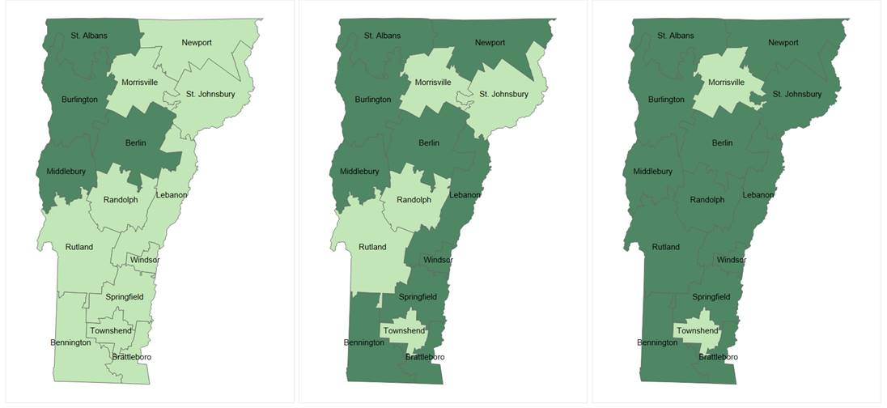
APM Progress Update
Regions participating in ACO through one or more payer contracts
Performance Year 0 (2017) | Performance Year 1 (2018) | Performance Year 2 (2019)
Participating
Not Participating
In 2019, participating providers include… | Hospitals (in all 12 participating regions)
Federally qualified health centers (6 regions) | Independent specialists (7 regions)
Independent primary care providers (8 regions) | Home health (all regions)
Designated mental health agencies (all regions) | Skilled nursing facilities (10 regions)
Notes:
MELISSA - While we anticipate that we are below our scale targets, as you can see from this slide, the geographic reach of the model has growth significantly between 2017, PY 0, and 2019, PY 2. We went from four communities participating in a Medicaid risk-based program in 2017 to all but two communities participating in at least one risk program in 2019.
Most regions are participating in at least Medicaid. That does not mean the entire community is participating.
OneCare and payers are working closely together to expand participation as payers seek to grow these programs.
Until there is scale in a community, you will not get benefits of the multi-payer alignment.

