Slide 1
EPODE and EPODE International Network
Notes:
1

Slide 2
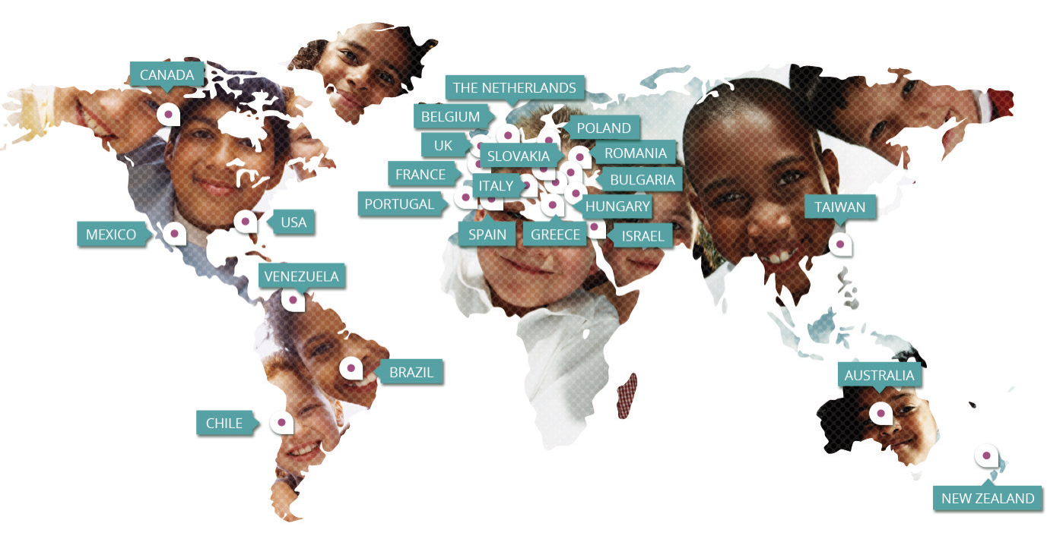
EPODE and the community: Together we can!
EPODE (Ensemble Prévenons l’Obésité Des Enfants= Together Let’s Prevent Childhood Obesity) is a coordinated, capacity-building approach for communities to help them change the local social norms, behaviours, environment and have an impact to improve and promote healthier lifestyles at the local level
EPODE Model has been disseminated to 46 programmes in 30 countries thanks to the EPODE International Network (EIN)
Notes:
EPODE approach for childhood obesity prevention: methods, progress and international development. Borys JM, Le Bodo Y, Jebb SA, Seidell JC, Summerbell C, Richard D, De Henauw S, Moreno LA, M. Romon M, Visscher TLS, Raffin S, Swinburn, B, the EEN Study Group. Obes Rev. 2012 Apr;13(4):299-315
Évolution de la prévalence du surpoids et de l’obésité chez les enfants de 4 à 11 ans entre 2005 et 2010 dans les villes « EPODE M Romon et al. . Nutrition clinique et métabolisme, Vol 24, N° S1, dec 2010, p. 58
Downward trends in the prevalence of childhood overweight in two pilot towns taking part in the VIASANO community-based programme in Belgium: data from a national school health monitoring system. Vinck, J.et al. (2015), Pediatric Obesity. doi: 10.1111/ijpo.12022

Slide 3
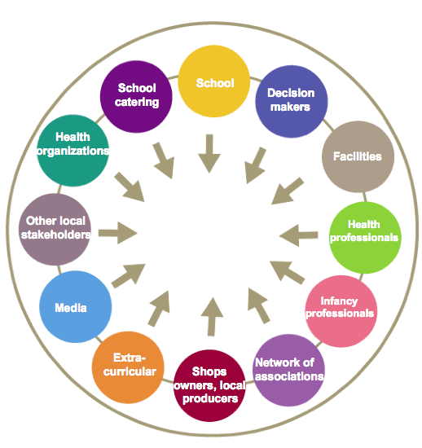
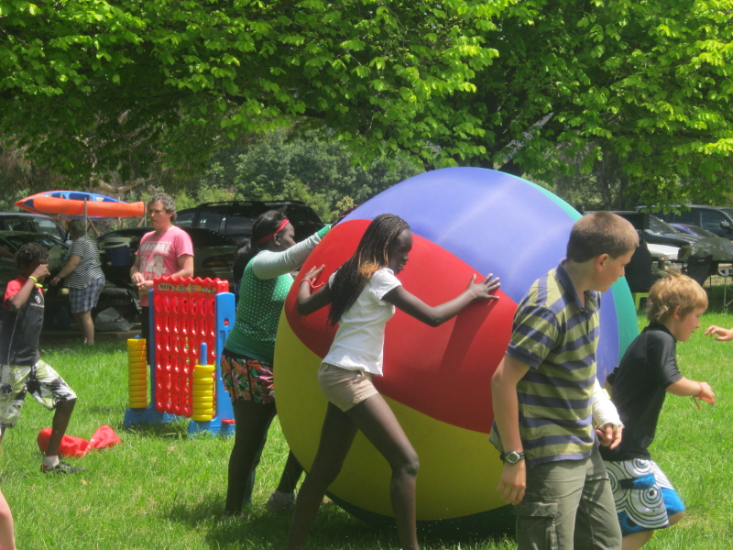
EPODE is a multistakeholder approach
1
Families and their children
Stakeholders who can influence childhood settings, food environments and physical activity environments, socio economic policies and socio cultural norms
2
Community level
FAMILIES

Slide 4
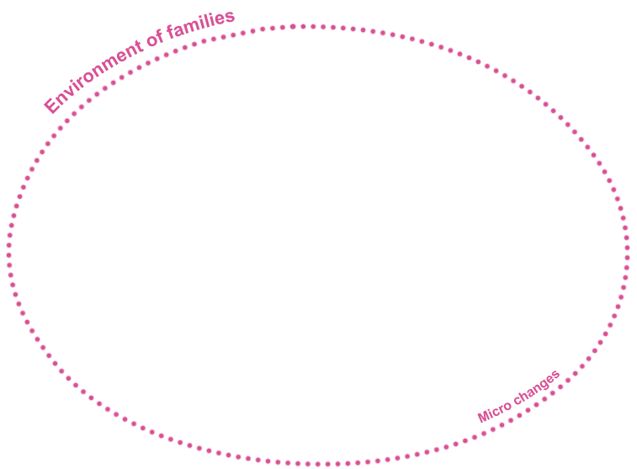
The EPODE Model
Independent
Scientific
Committee
Central level
Institutionnal
Support
Private
Partners
(Sponsors,
NGOs...)
EPODE
CENTRAL COORDINATION
Companies
MAYOR
Elected
Representatives
Media
Local
stakeholders
LOCAL PROJECT MANAGER
Local
level
Schools
LOCAL
STEERING
COMMITTEE
Health
Professionnals
Infancy
Professionnals
Other Local
Actors
Local
Associations
Extra-curricular
Activities
Notes:
In each country or region, EPODE promotes the involvement of a multi-level and multiple stakeholders approach at central level (endorsement from ministries, support from health groups, NGOs, and private partners) and benefits from the expertise and guidance of an independent scientific advisory board that provides general recommendations related to the implementation and the transferability of the methodology in other contexts.
To put the EPODE methodology into practice, a central coordination team, using social marketing and organisational techniques, trains and coaches a local project manager appointed in each community by the local political leader (e.g. the Mayor) able to champion the programme.
The role of the local project manager is to mobilize a multifaceted local steering committee and, by peer-to-peer dynamics, a diversity of local stakeholders especially in schools, pre-schools, extracurricular organizations and social network of associations, which are key settings to implement activities with children and families. So, the city or town is at the heart of the system.
The social mobilization group dynamics, involving a wide diversity of local stakeholders should play a role in impacting on local living conditions of the family, in order to facilitate the adoption of healthier lifestyles.
Advice to national or central EPODE coordination:
Do not want to measure everything;
Create an “Evaluation and Monitoring” Roadmap;
describe each step to be taken by central and local organisation;
Continuous deliberation with EPODE coordination team and other EPODE cities on indicators and measurement of indicators;
Create an “Evaluation and Monitoring of EPODE” Evaluation Course;
Identify experts in community health promotion evaluation in each EPODE country;
appoint an Evaluation Counsellor in the central coordination team;
decide on the measurement of common indicators (give advice to communities)
Ask for statistics to support evaluation set-up and in analysing the data
Establish a local evaluation group responsible for the evaluation of the programme; key-stakeholders should be involved in this group to secure sustainability.
EPODE is a coordinated, capacity-building approach for communities
EPODE’s goal is to enable community stakeholders to implement effective and sustainable strategies to prevent childhood obesity at local level
By changing the social lifestyle norms and behaviours especially in the field of nutrition and physical activity
Encouraging changes in the local environment to be less obesogenic
In the Epode methodology we have four pillars.
The first one is: creating a political commitment. If we want to prevent obesity, we need a very strong political will at all level from national (parlimentaries, institutions..) to local level (mayors, governors deputy mayors). This is the first point.
The second one is to mobilize resources: human and financial resources.
The third is to have coordination and support services (as for example social marketing and communication expertise).
The fourth: to have an evidence-based evaluation for what we are doing.
All these four pillars are to implement effective and sustainable strategies to prevent childhood obesity through a bottom-up and top-down multistakeholder approach (démarrage animation).
Therefore in each country or region, the EPODE methodology promotes the involvement of multiple stakeholders at central level (endorsement from ministries, support from health groups, NGOs, and private partners) and the programme benefits from the expertise and guidance of an independent expert committee.
To put the EPODE methodology into practice, a central coordination team, using social marketing and organisational techniques, trains and coaches a local project manager appointed in each community by the mayor (or other local leader able to champion the programme).
The role of the local project manager is to mobilize a wide diversity of local stakeholders, especially in schools, pre-schools, extracurricular organizations and social network of associations, which are key settings to implement activities with children and families.
For this purpose, the local project manager coordinates a multifaceted local steering committee of local representatives from various fields (elected representatives, heads of municipal services, school professionals, and local partners). This committee meets on a regular basis to make key decisions, foster the implementation of activities and actions, and generate peer-to-peer dynamics.

Slide 5
EPODE identified 4 critical factors which now form the 4 pillars of the EPODE Methodology & they work together
EPODE
Integrated Coordinated Sustainable Approach
1
3
4
2
+
+
+
Political Commitment
Resources including Public-Private Partnership Schemes
Support Services including social marketing expertise
Science/ Evidence-based and Evaluation
Challenges
Short political mandate
No immediate benefit(s) for Politicians
Conflict of interest issues
Funding
Multi-stakeholder approach
Conflicting agendas
Evaluation versus research
Cost
Agenda
Notes:
EPODE identified four critical factors, which now form the 4 pillars of the methodology:
1.A strong Political commitment at multiple levels: Gaining formal political commitment at central and local levels from the leaders of the key organisation(s), which influence national, federal or state policies as well as local policies, environments and childhood settings
2.An sound Evidence base and continuous evaluation Evidence: Using evidence from a wide variety of sources, to inform the delivery of EPODE and to evaluate process, impact and outcomes of the EPODE programme
3.Resources inlcuding PPP schemes: Securing sufficient resources to fund central support services and evaluation, as well as contributions from local organisations to fund local implementation
4.Support services including social marketing expertise : Planning, coordinating, and providing the social marketing, communication and support services for community practitioners and leaders

Slide 6
Can EPODE reduce children obesity prevalence? YES…
Notes:
6

Slide 7
EPODE’s impact on children overweight & obesity
Results FLVS, 1992 – 2004
Prevalence of Overweight and Obesity
Romon & Al., Public Health Nutrition, 2009; 12: 1735–1742
Notes:
EPODE Pilot Study Lessons & Results (FLVS, 1992 – 2004)
Aim: can we change families’ behaviors thanks children education and community mobilisation?
Control study: intervention and control towns
Lessons
Shows a dramatic decrease in the prevalence of Ow & Obesity in children when it involves the whole community (and not only the schools)
Allowed the Identification of the 4 pillars of the EPODE Methodology
Cost of evaluation: x 35 more expensive than the cost of the action itself
Romon & Al., Public Health Nutrition, 2009; 12: 1735–1742

Slide 8
EPODE’s impact on children overweight & obesity
Results France, 2004-2009
French Pilot towns:
-10%
21,0%
20,6%
20,5%
P < 0,0001
20,0%
Overweight and obesity rate %
19,5%
19,0%
n = 23617
18,5%
18,8%
18,0%
2005
2009
Romon & Al, Nutrition clinique & métabolisme,Vol 24, N° S1, dec 2010, 58
Notes:
Launch of the EPODE program France, 2004-2008
Aim: can we validate at large scale the FLVS hypothesis?
2004 - 2009: 10 pilot cities
More than 500 000 inhabitants & 50 000 children
Lessons
Same tendency in decreasing the prevalence of Ow & Ob
Funded and sustainable thanks to PPP
Political & Multi-stakeholder Endorsement Essential
Direct Cost is about 2 to 3 € / year / inhabitant

Slide 9
Results VIASANO Pediatric Obesity 2015
EPODE’s impact on children overweight & obesity
Accelerated by Belgian towns:
-22%
Overweight and obesity rate %
J.Vinck & all.Downward trends in the prevalence of childhood overweight in two pilot towns
taking part in the VIASANO community-based program in Belgium: Data from a national school health monitoring system. Pediatric Obesity. March 2015.
Notes:
VIASANO (Belgium) results after 2.5 years: significant 22% decrease in the prevalence of overweight in Marche & Mouscron. For Marche & Mouscron there was a significant decrease in the prevalence of overweight when compared to children with normal BMI levels (p<0.04)

Slide 10
Results
% overweight and obesity in children aged 4-13 years
Bronnen: ChecKid (OPOZ Windesheim en GGD Ijsselland) Landelijke groeistudie

Slide 11
FLVS Study in Northern France 1992-2004: A reduction up to 50% of the health inequities amongst overweight and obesity prevalence
30
25
20
15
10
5
0
x 4,7
Overweight and obesity prevalence (%)
x 2,7
n= 633 children
x 3
x 1,2
Control towns
EPODE towns
Upper Class
Middle Class
Lower Class
Downward trends in the prevalence of childhood overweight in the setting of 12-year school- and community-based programmes. Romon M, Lommez A, Tafflet M, Basdevant A, Oppert JM, Bresson JL, Borys JM et al. Public Health Nutr. 2009 Oct;12(10):1735-42.

Slide 12
EPODE FOR THE PROMOTION OF HEALTH EQUITY (EPHE): Closing the gaps after one year intervention
indicators
T0
T1
T0
T1
T0
T1
T0
T1
Fruits & Vegetables
Water consumption
Physical activity
Sleep
France
Greece
Portugal
Bulgaria
Belgium
Netherlands
Romania

Slide 13
In 2015,EIN has 46 member programmes across 30 countries
CANADA
THE NETHERLANDS
BELGIUM
POLAND
IRELAND
SLOVAKIA
UNITED KINGDOM
ROMANIA
FRANCE
BULGARIA
USA
ITALY
AUSTRIA
HUNGARY
PORTUGAL
CROATIA
CYPRUS
TAIWAN
SPAIN
GREECE
LEBANON
MEXICO
ISRAEL
VENEZUELA
SINGAPORE
BRAZIL
AUSTRALIA
CHILE
NEW ZEALAND
Notes:
In 2014 EIN has 42 PROGRAMME MEMBERS in 29 COUNTRIES
BRAZIL – AGITA SAO PAULO
CHILE – ELIGE VIVIR SANO
VENEZUELA- NUTRIR
MEXICO - MUEVETE Y METETE EN CINTURA
MEXICO - COLIMA - 5 PASOS POR TU SALUD PARA VIVIR MEJOR
MEXICO - HIDALGO - YA BÁJALE
MEXICO - SONORA- 5 PASOS - SONORA
MEXICO AGUASCALIENTES 2 - 5 PASOS POR UN AGUASCALIENTES SALUDABLE
MEXICO - PUEBLA - 5 PASOS POR TU SALUD EN FAMILIA
MEXICO - DURANGO - ATREVETE VIVE SALUDABLE EN 5 PASOS
MEXICO - AGUASCALIENTES - 5 PASOS POR TU SALUD
MEXICO - MONTEMORELOS - MONTEMORELOS ADELANTE CON 5 PASOS
MEXICO - EDOMEX 5 PASOS - CONTROL DE PESO EN CAPULHUAC
USA- WORLD FIT
CANADA – REAL FOOD FOR REAL KIDS
CANADA – HEALTHY KIDS COMMUNITY CHALLENGE
CANADA- BOYS AND GIRLS CLUBS
CANADA- HEART FOUNDATION
CROATIA – Croatian Medical Association *
AUSTRIA – SALTO *
CYPRUS – CEPS *
BELGIUM - VIASANO
BULGARIA – HEALTHY KIDS
FRANCE – EPODE
GREECE – PAIDEIATROFI
ISRAEL – HEALTHY LIVING
LEBANON – HEALTHY KIDS
Ireland- Sproai
ITALY - EUROBIS
THE NETHERLANDS – JOGG
POLAND – KEEP FIT
PORTUGAL – MUNSI
ROMANIA – SETS
ROMANIA – HEALTHY TRADITIONS
SLOVAKIA – SPORTTUBE
SPAIN – THAO
UNITED KINGDOM – PHUNKYFOODS
UNITED KINGDOM – BEAT THE STREET
AUSTRALIA – OPAL
AUSTRALIA – Prevention Community Model =Heatlhy Together Victoria
NEW ZEALAND – ENERGIZE
TAIWAN – HEALTH PROMOTION
SINGAPORE – HEALTH PROMOTION
HUNGARY – Children Health program Gyermekek Egészsége
*Pending Board approval
Upcoming: UAE-Dubaï – Healthy Kids and Saudi Arabia – Healthy Kids

Slide 14
RISE VT & EPODE
EPODE decreases childhood obesity rates between 10 to 20% over 3 to 5 years
According to Trust for America’s Health a decrease by 5% in obesity would lead to a savings of $29 B in the US
US Prevention Institute « for every $1 invested in community-based prevention, the return amounts to $5.60 »

Slide 15
EPODE added value for rise vermont
To accompany Rise VT to expand penetration depending on their need, based on our international experience for example:
Create a scientific advisory board for 2 pilots
Evaluation process: base assessment and assessment every 2 years on on children obesity + interim evaluation for each theme
Themes to be defined with the scientific Committee, coordinator and local stakeholders
Build a strategy for social marketing on these themes
Communication at the State level (vermont) and national level (USA)

Slide 16
EPODE International Coordination:
epode-international-network.com
@Epode_Network
paulineharper00@gmail.com
Notes:
16

