Slide 1
GREEN MOUNTAIN CARE BOARD SFY18 Proposed Budget
Kate Slocum, Budget Director
February 9, 2017

Slide 2
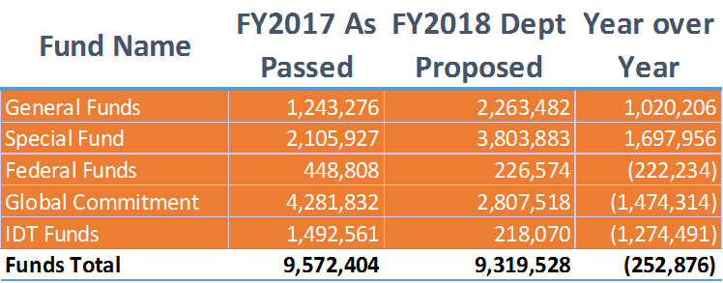
GMCB Budget SFY18

Slide 3
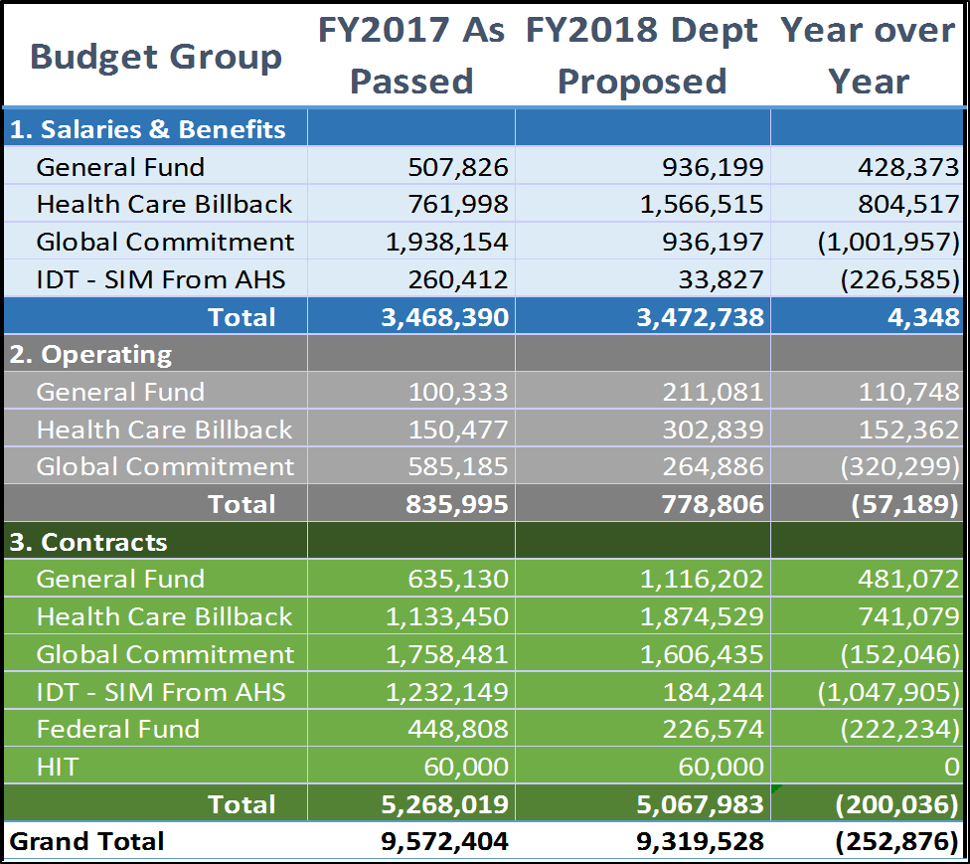
GMCB Budget SFY18

Slide 4
SFY18 Initiatives
Looking Forward:
APM and Act 113 Implementation
Funding for a Medicaid Rate Case
Funding for APM specific Contracts
Funding for 4th year of Shared Savings Program
Review of Hospital Budget Process
Hiring within the existing team
Assessing adequate resources available to the team
Review of Certificate of Need Process
Updating the HRAP
Price Transparency
Assessing the correct next steps for Vermont

Slide 5
SFY18 Budget Narrative
Instructions from Secretary of Administration was for a Level Funded Budget – reflects a 2.6% decrease
Moves the GMCB completely away from one time funds to state dollars while reducing some contracts and one grant position
This Budget includes the conversation of 4 positions from Limited Service Grant Funded status to Permanent Classified State Funded status
Fully staffs the APM team, 7 Positions total

